Slide 1
Writing a Business Plan
3-1-2024

Slide 2
Writing a Business Plan
Presented in partnership with…

Slide 3
Writing a Business Plan
Presented in partnership with…

Slide 4
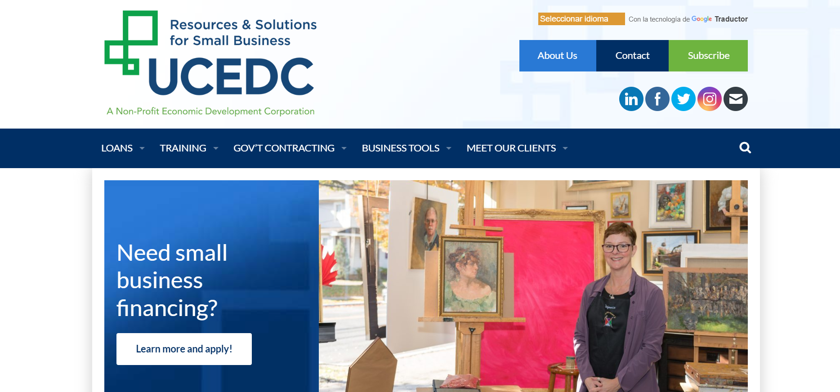
A Non-Profit
Economic Development Corporation
Notes:
Since 1977
private, non-profit economic development corporation,
dedicated to boosting local economies and strengthening communities through business development and job creation.
making loans, training and mentoring business owners, helping businesses obtain government contracts, and providing accurate and relevant business information.
a Community Development Financial Institution (CDFI) and SBA lender, UCEDC is committed to providing access to capital to underserved populations
SBA microloans, Community Advantage 7a loans, and 504 loans
partnership with a variety of counties and municipalities, to provide intensive small business training and mentorship services
Union County businesses can rely on UCEDC’s Procurement Technical Assistance Center (PTAC)to help navigate their way through the government contracting process.

Slide 5
Lending
Your business is more than a credit score to us
Community Development Financial Institution (CDFI)
US Small Business Administration (SBA) lender
Microloans – up to $50,000
SBA 7a Community Advantage loans – up to $250,000
SBA 504 Commercial Real Estate & Major Equip. loans – up to $5mil.
http://rsbdc.org
Notes:
Loans
Your business is more than a credit score to us.
As a Community Development Financial Institution (CDFI) and a US Small Business Administration (SBA) lender, we’re committed to helping start-up and existing small businesses throughout our expanded service area of New Jersey, New York City, Westchester County (NY), Philadelphia, and Bucks County (PA).
Take a look at our Loan Products to learn more about the various options we offer, including microloans, SBA 7(a) and SBA 504 loans. Our loans range from $500 to $5 million and we’ll work with you to find the right fit for your business.
Think you’re ready to apply? Our tips and checklists will get you started on building a strong application. You’ll learn what business basics must be in place before applying and the documentation you need to support your case.
Need a little inspiration? Check out our client stories and read about the savvy small business owners who leveraged a UCEDC loan into more revenue and new jobs.
Whether you’re just starting up or have been in business for years, UCEDC is ready to help. Let’s get started!
Loan Products
Access to capital is often a business owner’s largest hurdle. We fund a variety of small business loans to meet your needs at every stage of your business’s growth. With loans from $500 to $5.5 million*, our staff will work to find the solution that’s right for you.
LOAN PAYMENT CALCULATOR
(format loan amount as 25000, not $25,000)
Loan:
Interest rate:
Years:
Our interest rates provide you with a fair, affordable way to succeed. You’ll be assigned a rate between 3.25% and 8.25% based upon a number of factors:
Size of the loan
Age of the business
Financial performance of the business
Owner’s personal credit history
Owner’s industry experience
Your monthly payment may be more affordable than you think. Use our simple Loan Payment Calculator to test different loan amounts (format as 25000, not $25,000), interest rates (format as 7.0, not 7.0%), and payoff periods.
And our support doesn’t end at the loan closing – UCEDC staff will provide ongoing business mentoring services to help you keep on track. This one-on-one business counseling is entirely customized to meet the specific challenges and opportunities you face.
*UCEDC’s maximum portion of a 504 loan combined with bank partner financing can support projects as large as $20 million or more.
Click on a link below for a specific loan product or just scroll down to see all of our financing options.
Microloans – up to $50,000
SBA 7(a) Community Advantage Loans – up to $250,000
SBA 504 Commercial Real Estate and Major Equipment Loans – up to $5 million
Child Care Loans
Microloans – up to $50,000
UCEDC’s Microloan Program offers fixed-rate (between 5.25% – 8.25%) up to six-year loans with as little as 10% down for start-up and existing businesses in New Jersey, NYC and certain areas in NY and PA. Businesses in operation for less than two years can borrow a maximum of $35,000; established business with a profitable operating history are eligible for up to $50,000. There are no pre-payment penalties.
Microloan funds can be used for a broad array of business purposes, including purchasing equipment, fixtures or inventory; working capital; or making renovations on privately owned commercial real estate.
Check out our special limited time microloan offers
Rapid Response Loan Program: borrow up to $10,000, no collateral required, with a decision in two days or less! Learn more.
Prime Lock Loan Program: lock in your prime interest rate (currently 3.25%) for up to five years, no collateral required, up to $25,000. Learn more.
Your monthly payment may be more affordable than you think! CHECK HERE.
Take the first step Back to top↑
SBA 7(a) Community Advantage Loans – up to $250,000
UCEDC is one of a select group of lenders in the nation to provide this financing program, designed to encourage business growth and job creation. Our long-term loans (10-20 years) of up to $250,000 are available to existing businesses and up to $150,000 for start-ups (in operation less than two years) in New Jersey, NYC, and certain areas of NY and PA and feature flexible collateral requirements. Interest rates are Prime + 1% – 3%, with as little as 10% down.
Funds can be used for a wide variety of purposes including working capital; furniture/fixtures, machinery and equipment; land acquisition for commercial purposes; construction or renovation for privately owned commercial properties; leasehold improvements; and business acquisition.
Learn more and apply!

Slide 6
Training & Technical Assistance
Get the business skills you need to start, grow and thrive
Free workshops
Business Basics
Entrepreneurship Training Courses
Business Mentoring (one-on-one counseling)
Special Programs
Entrepreneurship as a Second Chance (ESC)
Virtual Incubator Program (VIP)
UCEDC Overview www.ucedc.com
http://rsbdc.org
Notes:
Training & Counseling
Get the business skills you need to start, grow and thrive.
Take advantage of our free workshops, offered throughout New Jersey. We’ll take you through the ins and outs of financing your business, understanding your credit score and other financial topics. You’ll also get the latest insights on franchising, pricing and marketing initiatives.
Ready to get serious about developing and implementing a strategic business plan? Then our Entrepreneurial Training programs are what you’re looking for.
Start-ups will test their business readiness in Entrepreneurship 101: are you really ready to start your business?
And speaking of enthusiasm, when you read our client stories, you’ll see why we’re so excited about their small business success.
Check our calendar for a training event near you. And sign-up to receive email alerts as new programs are announced.
Business Basics
These free two-hour workshops address a variety of business concerns for both start-up entrepreneurs and established business owners. They are offered throughout New Jersey, often in cooperation with partner organizations and agencies that share our commitment to small business growth. Learn more.
Entrepreneurial Training
This intensive seven-week course is offered to our contract partners in NJ, for economic development assistance, to help those start-ups & early-stage businesses build a solid business plan for seeking viable financing options. These start-ups and early-stage businesses, will get the help they need, both in the classroom and out, to survive and thrive in any economy. For more information and registration, visit our Entrepreneurship 101 pages.
Business Mentoring
UCEDC loan clients and Entrepreneurial Training graduates receive free individualized business counseling. Your UCEDC business mentor is your board of directors, CFO, and marketing manager, all rolled into one. Your mentor meets with you at your convenience, acts as your sounding board, and offers feedback, advice and suggestions to keep your business on track.
Special Programs
Entrepreneurship as a Second Chance (ESC)
The Entrepreneurship as a Second Chance (ESC) initiative offers formerly incarcerated, or court-involved individuals the opportunity to explore re-entry into society through business ownership. In addition to intensive entrepreneurial training (7-week Entrepreneurship Course), two years of one-on-one mentoring, and business plan development, ESC will provide participants with the necessary tools for success…including computers, business software, and the potential for start-up financing.
Virtual Incubator Program (VIP)
The Virtual Incubator Program (VIP) will provide businesses owners, from underserved populations, the opportunity to thrive through these trying economic times by offering education and access to capital. The program will include virtual training sessions: eight weeks of a Business Survival Series workshops and Group Mentoring classes, plus one-on-one counseling. Upon completion of the training, participants will receive forgivable loans of up to $10,000 at 0% interest, along with continued individual counseling for the life of the loan.
Want to start a small business? Well, don’t…until you try our new Entrepreneurship Self-Assessment Tool. Find out if you have what it really takes to run a successful small business. Don’t worry, we’re here to help. Get started.

Slide 7
APEX Accelerator
APEX Accelerator is your gateway to Government Contracts
Free seminars
One-on-one counseling
Registrations & Certificates
Identifying bid leads
Marketing to purchasing agents
Proposal development
Regulations & Military Specifications
Subcontracting assistance
Government Services Administration (GSA)
UCEDC Overview www.ucedc.com
http://rsbdc.org
Notes:
Procurement Technical Assistance Center (PTAC): Your Gateway to Government Contracts
Government agencies purchase billions of dollars worth of goods and services produced by small businesses. If you’re looking to participate in the government marketplace, the UCEDC Procurement Technical Assistance Center (PTAC) can give you the advantage you need.
UCEDC’s PTAC program is a free, comprehensive resource that gives businesses a wealth of information on how to market and sell their products and services to government agencies.
Our procurement specialists have over 24 years of combined experience in private industry and government procurement. So, whether you’re just starting out with government bids or are looking to build on past success, we can help.
How we Help your Business Grow
One-on-one Counseling
UCEDC’s procurement specialists will work with you to identify and build relationships with the right federal, state and local agencies that buy your products and services. We also help you develop targeted marketing strategies.
Registrations & Certifications
We’ll guide you through the complex process of government registrations and assist you in becoming a qualified government contractor. We can also help you with the certification process for small business programs.
Identifying Bid Leads
We match your company’s product or service with daily bid notices. Each day, our electronic bid match system scans a list of government solicitations that show what specific agencies are planning to buy. Then we notify you of bids relevant to your individual product or service.
Marketing
Our team will help you build relationships with government purchasing agents. You’ll have greater success if you market your product or service to the right buyer.
Proposal Development
Producing a clear, responsive proposal is key to winning contracts. We’ll review your proposal as it evolves and recommend ways to make it stronger and more compelling.
Free Seminars
UCEDC offers free seminars presented in partnership with federal, state and local agencies to help you better understand their particular needs and identify new opportunities.
Regulations & Military Specifications
We educate clients about federal, state and local government regulations and procedures that govern procurement. We’ll help you stay in compliance with these sometime confusing rules and regulations.
Subcontracting Assistance
We help identify possible business opportunities with prime contractors that offer subcontracting work to small businesses. These arrangements can open new markets for your business.
General Services Administration (GSA)
The GSA connects vendors to thousands of government agencies . Every year, the government buys billions of dollars in goods and services from GSA schedules, eliminating the need for direct bidding. Our experienced staff will explain the GSA schedule program to you and see if it’s a good match for your business.

Slide 8
Writing a Business Plan
INTRODUCTIONS
Name/Business
New or existing business
Type of business
First UCEDC workshop?
Alejandro

Slide 9
Writing a Business Plan
Workshop Objectives
Purpose of a business plan (not just for startups)
Components of an effective Business Plan
Resources for writing a business plan

Slide 10
Why Write a Business Plan?
Benefits of Writing a Business Plan:
Assess or Re-assess your business
Describe goals & objectives
Guideline to reach financial goals
Be prepared for crises (i.e. COVID-19)
Determine need for financing
Help you explain your concept
Notes:
5 Minutes on this slide
The most common thing an entrepreneur hears about before going into business is the need for a business plan. Many people sit down and begin to draft a business plan without really thinking about what it should be. After going through our assessment process, we have an understanding of what we want our business to be and what we want/need from it. In creating a business plan, we’re now giving ourselves the strategy to execute that will enable us to reach those goals and objectives.

Slide 11
Your Entrepreneurial Assessment
Assessment
Personal Readiness
Idea
Market
Financial
Organization
Notes:
The first part of the assessment process is your personal readiness. It doesn’t make sense to forge ahead with a business idea if you don’t have the mindset and resources to give yourself a chance to be successful in business. Be totally honest with yourself and the potential for your business.

Slide 12
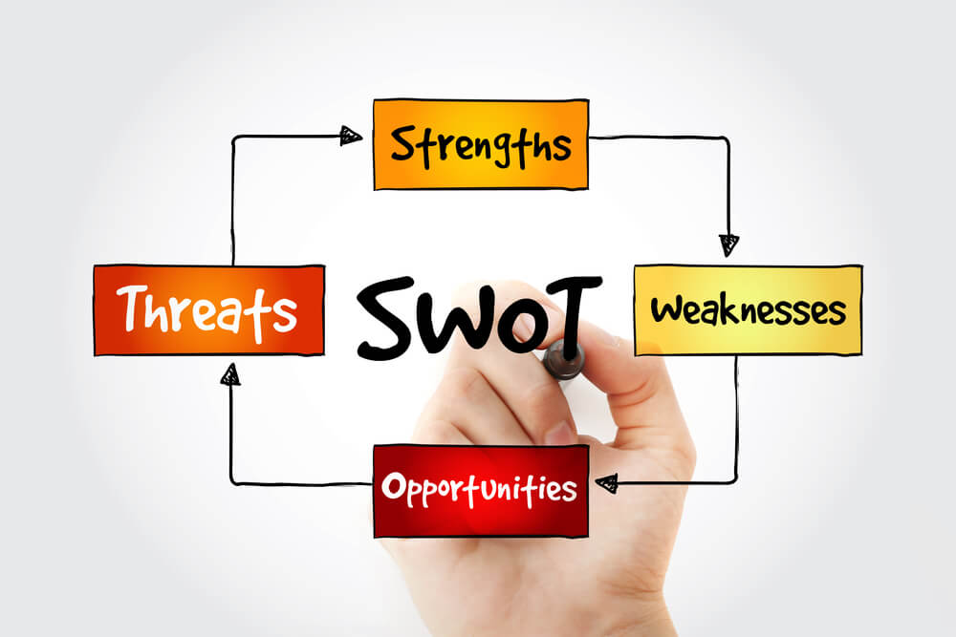
SWOT Analysis
Notes:
A very effective exercise for assessing your business is the SWOT Analysis!
This is a great “primer” before starting to actually write the business plan. Again, be totally honest with yourself and the potential for your business.
Take a high level look at areas of your business (and yourself) to review/reassess what you need to do to build a foundation for a successful business.
It helps you to build on what you do well, to address what you're lacking, to minimize risks, and to take the greatest possible advantage of chances for success.
Strengths
Strengths describe what an organization excels at and what separates it from the competition: a strong brand, loyal customer base, a strong balance sheet, unique technology, and so on. For example, a hedge fund may have developed a proprietary trading strategy that returns market-beating results. It must then decide how to use those results to attract new investors.
Weaknesses
Weaknesses stop an organization from performing at its optimum level. They are areas where the business needs to improve to remain competitive: a weak brand, higher-than-average turnover, high levels of debt, an inadequate supply chain, or lack of capital.
Opportunities
Opportunities refer to favorable external factors that could give an organization a competitive advantage. For example, if a country cuts tariffs, a car manufacturer can export its cars into a new market, increasing sales and market share.
Threats
Threats refer to factors that have the potential to harm an organization. For example, a drought is a threat to a wheat-producing company, as it may destroy or reduce the crop yield. Other common threats include things like rising costs for materials, increasing competition, tight labor supply. and so on.
SWOT Table
Strengths 1. What is our competitive advantage? 2. What resources do we have? 3. What products are performing well?
Weaknesses 1. Where can we improve? 2. What products are underperforming? 3. Where are we lacking resources?
Threats 1. What new regulations threaten operations? 2. What do our competitors do well? 3. What consumer trends threaten business?
Opportunities 1. What technology can we use to improve operations? 2. Can we expand our core operations? 3. What new market segments can we explore?

Slide 13
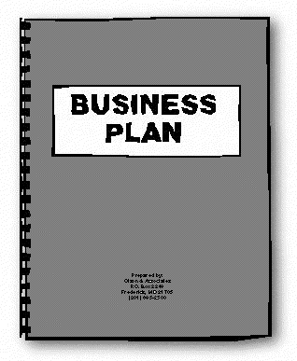
Components of the Business Plan
Executive Summary
Company Description
Products/Services
Marketing Plan
Operations & Management Plan
Financial Plan
www.SMARTmarketingpartners.com
www.SMARTmarketingpartners.com
er.org
Notes:
Creating a business plan can:
Help you discover any weaknesses in your business idea so you can address them before you open for business
Identify business opportunities you may not have considered and plan how to take advantage of them
Analyze the market and competition to strengthen your idea
Give you a chance to plan strategies for dealing with potential challenges so they don’t derail your startup
Convince potential partners, customers and key employees that you’re serious about your idea and persuade them to work with you
Force you to calculate when your business will make a profit and how much money you need to reach that point, so you can be prepared with adequate startup capital
Determine your target market and how to reach them
Laying out a detailed, step-by-step plan gives you a blueprint you can refer to during the startup process and helps you maintain your momentum.
Refer to slide, discuss each of the components of the business plan
Executive summary This is your five-minute elevator pitch. It may include a table of contents, company background, market opportunity, management overviews, competitive advantages, and financial highlights. It’s probably easiest to write the detailed sections first and then extract the cream to create the executive summary. Try to keep it to just a couple of pages.
Company description and structure This is where you explain why you're in business and what you're selling.
Products and Services
Marketing plan (research and strategies)
Operations & Management plan
Financial documents Suggest calculating this first before doing anything else. Analyze the financial potential of you running this business.

Slide 14
Company Description
Describe the business
Legal structure
Your products and services
Identify target customer
Business ownership
Brief history if existing business (or acquisition)
Location factors
Hours of operation
www.SMARTmarketingpartners.com
www.SMARTmarketingpartners.com
htt
Notes:
Refer to slide, discuss each of the components of the business plan
Company description and structure This is where you explain why you're in business and what you're selling.
If you sell products, describe your manufacturing process, availability of materials, how you handle inventory and fulfillment, and other operational details.
If you provide services, describe them and their value proposition to customers. Include other details such as strategic relationships, administrative issues, intellectual property you may own, expenses, and the legal structure of your company.
Describe the business
Your products and services
Identify target customer
Business ownership
Legal structure
Address
Hours of operation
Brief history if existing business (acquisition)

Slide 15
…More on Products & Services
How product is produced
Distribution description
How service is performed
Advantages/benefits
Warranties/guarantees?
Menus/Catalogs?
Suppliers and Initial Purchase Levels
www.SMARTmarketingpartners.com
www.SMARTmarketingpartners.com
Notes:
Refer to slide, discuss each of the components of the business plan
Company description and structure This is where you explain why you're in business and what you're selling.
If you sell products, describe your manufacturing process, availability of materials, how you handle inventory and fulfillment, and other operational details.
If you provide services, describe them and their value proposition to customers. Include other details such as strategic relationships, administrative issues, intellectual property you may own, expenses, and the legal structure of your company.
Describe the business
Your products and services
Identify target customer
Business ownership
Legal structure
Address
Hours of operation
Brief history if existing business (acquisition)

Slide 16
Marketing Plan
How will you position your business
Target Market
How Product/service appeals to target
Apply 4Ps to target (product, price, place, promotion)
Marketing Budget
www.SMARTmarketingpartners.com
www.SMARTmarketingpartners.com
Notes:
Refer to slide, discuss each of the components of the business plan
Marketing plan (research and strategies) Spell out your market analysis and describe your marketing strategy, including sales forecasts, deadlines and milestones, advertising, public relations and how you stack up against your competition. If you can’t produce a lot of data analysis, you can provide testimonials from existing customers.
How will you position your business
Target Market
Product/service to be sold
Marketing Budget
PR tools
Follow-up strategy

Slide 17
…about the market (industry)
Industry profile & trends
Market potential (your area demographics)
Identify the characteristics & attributes of your target market/customer profile
Describe Customer Needs & Wants
Describe purchasing habits
Analysis of Competitors
Growth potential?
www.SMARTmarketingpartners.com
www.SMARTmarketingpartners.com
g
Notes:
Refer to slide, discuss each of the components of the business plan
Marketing plan (research and strategies) Spell out your market analysis and describe your marketing strategy, including sales forecasts, deadlines and milestones, advertising, public relations and how you stack up against your competition. If you can’t produce a lot of data analysis, you can provide testimonials from existing customers.
Industry profile & trends
Market potential (your area demographics)
Identify the characteristics & attributes of your target market
Describe Customer Needs & Wants
Describe purchasing habits
Growth potential?

Slide 18
…do the marketing research
Secondary Research
Trade publications, websites, etc
NJ State Library System “Jersey Clicks” (Reference Solutions)
Primary Research
Networking clubs, groups in your business sector
Local chambers of commerce and business associations
www.SMARTmarketingpartners.com
www.SMARTmarketingpartners.com
Notes:
Refer to slide, discuss each of the components of the business plan
Marketing plan (research and strategies) Spell out your market analysis and describe your marketing strategy, including sales forecasts, deadlines and milestones, advertising, public relations and how you stack up against your competition. If you can’t produce a lot of data analysis, you can provide testimonials from existing customers.
Secondary Research
Trade publications, websites, etc
NJ State Library System “Jersey Clicks” (Reference Solutions)
Primary Research
Networking clubs, groups in your business sector
Local chambers of commerce and business associations

Slide 19
Operations & Management Plan
Owner personal history
Education/Credentials
Related work experience
Duties & responsibilities
Owner compensation
Other managers and employees
Roles, responsibilities, compensation
Job descriptions
www.SMARTmarketingpartners.com
www.SMARTmarketingpartners.com
Notes:
Refer to slide, discuss each of the components of the business plan
Operations & Management plan Provide bios of your company executives and managers and explain how their expertise will help you meet business goals. Investors need to evaluate risk, and often, a management team with lots of experience may lower perceived risk.
Owner personal history
Education/Credentials
Related work experience
Duties & responsibilities
Owner compensation
Other managers and employees
Roles, responsibilities, compensation
Brief Job Description

Slide 20
Financial Documents
Basic Financial Statements
Balance Sheet
Profit/Loss (Income Statement)
Cash Flow
Sources/Uses of funds
Capital Equipment Startup Costs
Break even analysis
www.SMARTmarketingpartners.com
www.SMARTmarketingpartners.com
Notes:
Refer to slide, discuss each of the components of the business plan
Financial documents This is where you provide the numbers that back up everything you described in your organizational and marketing sections.
Include conservative projections of your Profit and Loss statements (Income Statement), Balance Sheet, and your Cash Flow Statements for the next three years.
These are forward-looking projections, not your current accounting outputs.
Should also include
Sources/Uses of Funds
Capital Equipment List or Startup Costs for new businesses
Break Even Analysis for Startups/New Businesses

Slide 21
Your Entrepreneurial Readiness
Emotional readiness
Personal work style
Skills and resources
Notes:
Start with a SELF-assessment. Being an entrepreneur isn’t for everyone. There are lot of factors that need to be in place to make sure you’re putting yourself in the best possible position. Take some time to go through a self-assessment survey on entrepreneurship.
Emotional: 10,000 hour rule. Family support – both emotional and financial
Personal work style: SWOT yourself! BE HONEST!
Skills/resources: No one can do it all themselves. Sole proprietor vs business owner. Attorney, Accountant, Insurance, ADVISORY BOARD…and STAFF!
For complete survey: UCEDC.com/Business Tools/Entrepreneurship Self Assessment Tool https://ucedc.com/entrepreneurship-self-assessment/

Slide 22
Your Personal Finances
Household budget
Personal financial statement
Equity/collateral
Credit
Notes:
Personal finances also play a large role in determining if you’re ready to be an entrepreneur. You need to look at a number of different items:
How does the revenue you project your business will supply tie in with household needs?
What are the long term financial goals you have?
How much can you invest in your business?
Can you access capital?
Do you know your credit score and will it cause a barrier to opening a business?
These items are critical for starting a business.

Slide 23
Balance Sheet
Assets – Liabilities = Net Worth
Home Equity Mortgage
Collateral Education Loans
Savings Vehicle Loans
Credit Cards
Notes:
The accountants equation is what governs the Balance Sheet Accounts! All accounting rests on this equation!! (Very Important).
Your personal financial statement shows your personal net worth. A snapshot. This can be used to show how much you can invest into a business, what assets are available for use as collateral, and how many resources are available to you to supplement your income during the start-up phase.
Also includes your debts. The companies best positioned to weather COVID had low debt…which translate into monthly expenses that are captured in….

Slide 24
Income and Cash Flow
How long can you survive on little to no income?
Assessment of money coming in
And money going out
Notes:
…Income and Cash Flow statements. Because your net worth doesn’t pay the bills. IT’S ALL ABOUT THE CASH FLOW
We all need money to live on. Whether it’s to pay a mortgage, rent, food, clothing, etc. We need to determine that we can survive on little to no income from the business in it’s early stages. We need to do a hard assessment of what money we have coming in and what our expenses are.

Slide 25
www.annualcreditreport.com
Know Your Credit Report!
www.SMARTmarketingpartners.com
www.SMARTmarketingpartners.com
rg
Notes:
Knowing how to manage one’s personal credit starts with getting copies of all three credit reports for free at www.annualcreditreport.com, which shows the details of your credit history without a score. By law you are entitled to receive each report once a year at no charge. If you want to see your scores you do have the option to include that for a fee. Many people create a reminder system to access one report every four months, for free, in order to see new information more regularly. Each report will list all accounts (“tradelines”) as reported to each credit bureau. You’ll have the opportunity to challenge and correct any inaccuracies which could be affecting your score.

Slide 26
Your Entrepreneurial Assessment
Assessment
Personal Readiness
Idea
Market
Financial
Organization
www.SMARTmarketingpartners.com
www.SMARTmarketingpartners.com
http://rsbdc.org
Notes:
Let’s move on to the next part of the assessment process; your idea.
(We’ll cover Idea, Market, and Organization in the first two parts of the series and Financials in the last two parts)

Slide 27
Your Business Idea
Is there (still) an unmet need?
Product
Price
Place
Promotion
www.SMARTmarketingpartners.com
www.SMARTmarketingpartners.com
Notes:
Have you done research to validate you are filling an unmet need?
Examples of some companies that reassessed and repositioned one or more of their 4 Ps:

Slide 28
Your Entrepreneurial Assessment
Assessment
Personal Readiness
Idea
Market
Financial
Organization
www.SMARTmarketingpartners.com
www.SMARTmarketingpartners.com
www.NBRChamber.org
http://rsbdc.org
Notes:
And of course you need to clearly define (or re-define) your target market.

Slide 29
Reassessing Your Market
Market
A group of people or institutions that possess purchasing power, authority and willingness to purchase.
Target Market/Customer Profile
Group of people to whom a company markets its products and/or services to satisfy their specific needs.
Market Segmentation
Process of dividing the total market into relatively similar groups.
www.SMARTmarketingpartners.com
www.NBRChamber.org
http://rsbdc.org
Notes:
The center piece in the 4Ps diagram. It’s all about LIST! Who are you marketing to? KYC As we’ll see later, List can have 5x greater impact than Offer and Creative.
Segmentation: 80/20 rule (Beneficial example) Find your most profitable segments!
Examples of COVID companies who’ve reassessed/redefined their market:

Slide 30
Reassessing Your Competition
www.SMARTmarketingpartners.com
www.SMARTmarketingpartners.com
http://rsbdc.org
Notes:
Competitors can be classified into three groups:
Direct – those that offer the same product or service within the same geographic region as you. For example, say you own an Italian restaurant in a downtown area that’s trying to appeal to a more upscale crowd. If there is another restaurant a block away they are a direct competitor since you are both trying to attract the same customer, someone who wants to go to dinner in the downtown area. Even if you have different offerings (i.e. an Italian restaurant vs. an Japanese restaurant), you are still offering the same type of product. Identifying the things that make you different are keys to your marketing efforts.
Indirect – those that offer a similar product or service within the same geographic region, or that offer the same product/service in a more remote geographic area. Indirect competitors may have some qualities that appeal to your target market but not all of them. Using our same example, an indirect competitor may be upscale restaurants outside of a 5 or 10 mile radius. Another example might be more casual restaurants in the same geographic area. While they appeal to a different crowd, they may still compete for your target customers. How about a personal chef who will come to your house and cook also as an alternative.
Remote – those that do not offer the same products or services, but still compete for the customers dollars. Let’s look at a restaurant that is trying to appeal to the casual dinner crowd. While it is easy to determine direct competitors (other restaurants in the immediate area), and indirect competitors (casual restaurants in the immediate area or upscale restaurants a further distance away), we cannot forget the remote competitors. Other establishments might also be competing for the same dollars that the consumer is looking to spend on their leisure activities.

Slide 31
Reassessing Your USP
Unique Selling Proposition (USP)
What sets you apart from the others
Notes:
Now that we have defined who our target market is and who the competition is, we can start to determine what, if anything makes us unique. Everyone needs to find some way to distinguish themselves from the competition. They need to give customers a reason to buy from them.

Slide 32
Your Organization
Assessment
Personal Readiness
Idea
Market
Financial
Organization
www.SMARTmarketingpartners.com
www.SMARTmarketingpartners.com
www.NBRChamber.org
http://rsbdc.org
Notes:
Now let’s focus on the next part of your assessment process; your organization. What are the skills, functions and resources required for success?
Organization, in this context, means the skills needed to get the business started. A lot of entrepreneurs suffer from the “superman” (or “superwoman” complex that they can do it all. One of the most important traits of a business owner is to identify what they can do as well as what they can’t do. It’s OK to learn and develop all the skills needed to run your business over time, but if you have deficiencies up from t that your not addressing, you may be setting yourself up to fail before you even get going.
Discuss examples of businesses that struggled because management didn’t address their deficiencies (Prep Boyz?).
When we completed our initial survey, we talked about some of the skills sets needed to be a business owner.

Slide 33
Identifying Skill Needs and Gaps
Identify the key processes of your business
What skills do you need to accomplish them?
Identify the ones you don’t possess
How will you “bridge the gaps”?
www.SMARTmarketingpartners.com
www.SMARTmarketingpartners.com
www.NBRChamber.org
http://rsbdc.org
Notes:
After identifying our strengths and weaknesses relating to starting our business, as well as what opportunities or threats exist, we need to now determine what processes are critical to the business. For instance, let’s say you want to be a landscaper. If you don’t possess management skills, but intend to start as a one-person operation, it’s not an immediate skill gap to opening your business. But if you determined that there is an opportunity to grow due to new construction or maybe knowing that one of the key competitors is closing their business, it might prevent you from expanding. You’ll need to either develop those skills or hire a manager to close that gap.
However, if you intend to have multiple teams running when you begin, you will need to address the situation of having someone with management skills right out of the gate.

Slide 34
Evaluation of Skill Sets
Who will do the work?
Owner
Employee
Advisor/Board Member
Outside resources
www.SMARTmarketingpartners.com
www.SMARTmarketingpartners.com
www.NBRChamber.org
http://rsbdc.org
Notes:
Full-Time/W-2 vs P-T/1099? Outsourced?
Attorney – assisting you with any start-up filings and designations as well as for things such as review of lease documents, guidance on personnel matters, contracts, etc.
Accountant – Also can assist with the legal formation by guiding you to the best set-up from your personal and tax situation. Will also be needed for advising on tax filings that need to be done, tax preparation and set-up of books & records.
Insurance agent – Will assist you on what type of insurance your business needs.

Slide 35
Writing a Business Plan
Questions?
Comments?
Feedback?

Slide 36
Contact UCEDC Training…
Mary Adelman madelman@ucedc.com
Jairo Borja jborja@ucedc.com
Alejandro Cruz acruz@ucedc.com
Tim Moore tmoore@ucedc.com
Joe Lamberti jlamberti@ucedc.com
www.ucedc.com

Slide 37
SWOT Analysis
Example 1: Fitness Center
Pre-COVID situation:
Personal fitness and training center
In business 10 years, loyal customer base
Target audience: BtoC age 40+ yrs, upscale area
One-on-one in-person training sessions
Rents 1st floor of large facility to conduct trainings
1 full-time trainer (owner), 1 p/t assistant
Business discontinued during COVID shutdown

Slide 38
SWOT Analysis: Fitness Center
Strengths
Experienced, subject matter expert
Age “niche” (40+ year olds)
Weaknesses
Local, constrained by geography
Delivery limited to in-person
One-on-one model limits scale oppty’s
High rent and overhead costs
Opportunities
Offer virtual training (overcomes COVID, expands geogr. reach)
Offer group trainings (further scales customer base & revenue)
Explore BtoB (corporate oppty’s)
Share space for F2F to save cost
Threats
Increasingly crowded local competition
Owner overextended – trying to do all marketing, admin and training himself
Notes:
Use the SWOT to assess INTERNAL (S+W) and EXTERNAL/competitive (O+T) aspects of your business. Leverage Strengths, shore up Weaknesses, address Threats, take advantage of Opportunities.
Look at each of the Ps in the Marketing Mix…..Product, Place (incl. market (audience, location), Price – AND Target Market….for business improvement and messaging strategies
Examples:

Slide 39
Contact UCEDC Training…
Mary Adelman madelman@ucedc.com
Jairo Borja jborja@ucedc.com
Alejandro Cruz acruz@ucedc.com
Tim Moore tmoore@ucedc.com
Joe Lamberti jlamberti@ucedc.com
www.ucedc.com

Slide 40
Contact Michelle Richardson…
Michelle Richardson
mrichardson@hudsonedc.org

Slide 41
Contact Sheila Adams…
Sheila Adams
sharrisadams@njcu.edu

